Slide 1
Lecture #1

Slide 2
Unit 1 a: Introduction to Microsoft Excel
Introduction to Microsoft Excel :
UI Basics : Introduction to UI basics
About excel
Workbooks and worksheets
Customizing excel
Reference styles
Number formatting
Custom number formatting,
Conditional formatting
Format as table

Slide 3
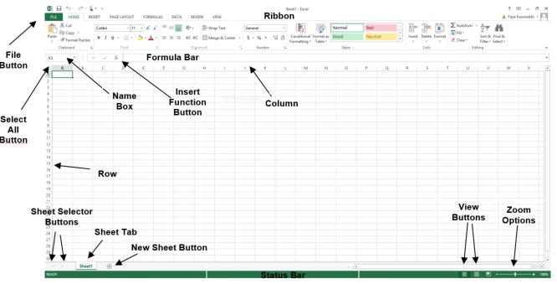
1. UI Basics : Introduction to UI basics
INT510, Lovely Professional University, Phagwara
Notes:
https://training-nyc.com/learn/excel/user-interface

Slide 4

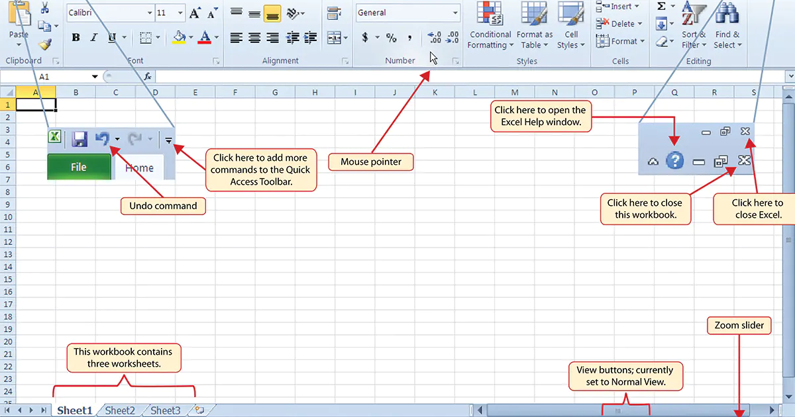
INT510, Lovely Professional University, Phagwara

Slide 5
Interface Element | Description
Ribbon Tabs | Ribbon Tab is a tab that organizes commands by topic
Ribbon Groups | Grouping of related commands
Dialog Box Launcher | Opens a dialog box that includes additional commands
Quick Access Toolbar | One click access to any frequently used command
Name Box | Displays cell location and can be used to navigate to a cell location
Select All Button | Selects all the cells in a worksheet
Formula Bar | View, enter, or edit cell contents
Insert Function Button | Displays Insert Function dialog box
Scroll Bars | Used to navigate up, down, left & right
Zoom Slider | Zoom into an area of the worksheet
View Buttons | Switch between Normal, Page Layout and Page Break Preview views
Worksheet tabs | Tabs used to select individual worksheets
The Workspace | The area inside of the columns and rows used in Excel
Columns | Columns use letters
Rows | Rows use numbers
INT510, Lovely Professional University, Phagwara

Slide 6
2. About excel
Microsoft Excel is a spreadsheet program that allows users to record and analyze numerical and statistical data.
It is compatible with multiple operating systems, including Windows, macOS, Android, and iOS
INT510, Lovely Professional University, Phagwara

Slide 7
Here are some features of Microsoft Excel:
Spreadsheets and data organization
Formulas and functions
Data visualization (pivot tables, pivot charts)
Data sorting and filtering
Data analysis toolpak
  A free, built-in Excel add-in that provides tools for financial, statistical, and engineering data analysis. It contains statistical methods such as Correlation, Regression, ANOVA, t-test, and Z test.
INT510, Lovely Professional University, Phagwara

Slide 8

3. Workbooks and worksheets
https://study.com/academy/lesson/what-is-a-workbook-in-excel-characteristics-and-options.html
INT510, Lovely Professional University, Phagwara
Notes:
https://study.com/academy/lesson/what-is-a-workbook-in-excel-characteristics-and-options.html#:~:text=In%20Excel%2C%20what%20is%20the,single%20spreadsheet%20to%20organize%20data.

Slide 9
Purpose: Workbooks are used to organize and manage data, while worksheets are used for calculations, data entry, and data analysis.
Structure: A worksheet is a single-page spreadsheet that contains a matrix of rectangular cells organized in rows and columns. A workbook can contain one or more worksheets, each containing related information.
Sharing: A workbook can be shared with other users via email, OneDrive, and cloud storage. A worksheet can only be shared with the workbook, not separately.
INT510, Lovely Professional University, Phagwara

Slide 10
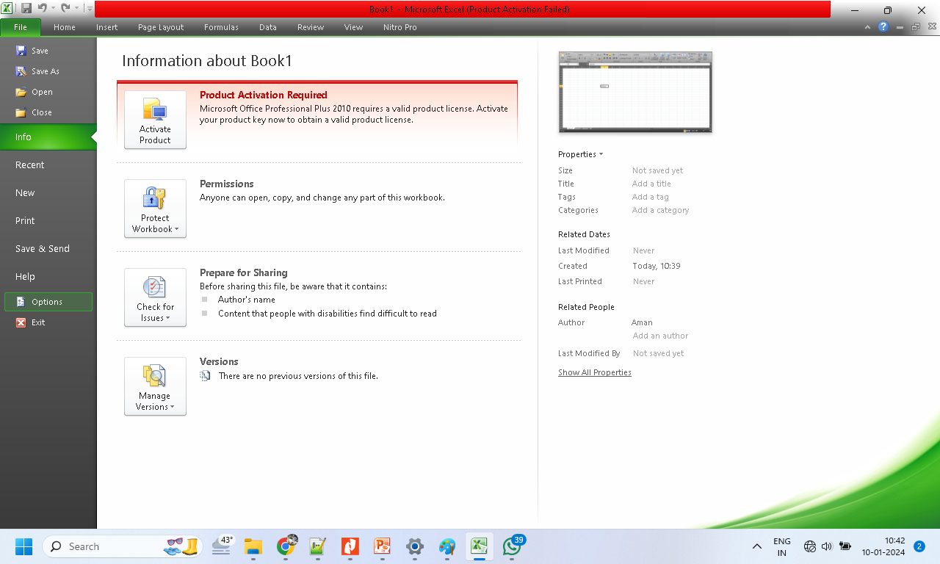
4. Customizing excel
INT510, Lovely Professional University, Phagwara

Slide 11
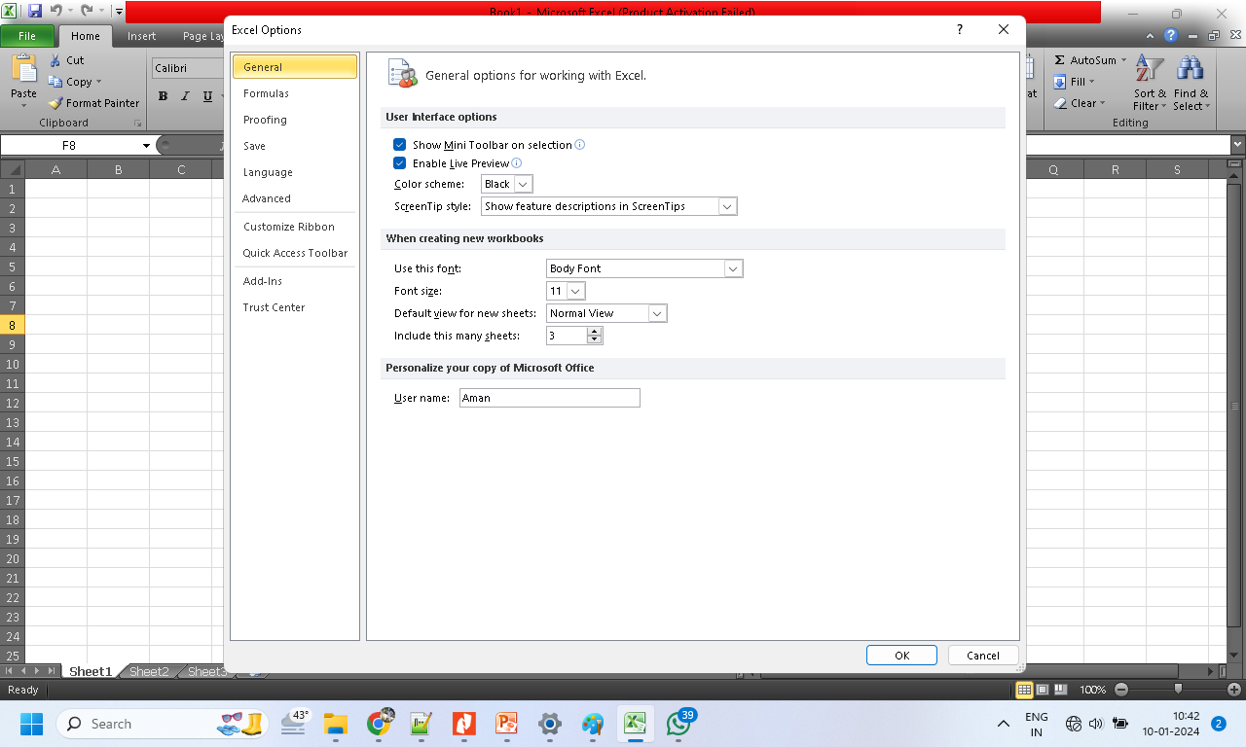
INT510, Lovely Professional University, Phagwara

Slide 12
Customizing excel, contd…
Open the File menu and select Options from the left navigation pane to open the Excel Options dialog box.
The dialog box has categories for General, Formulas, Data, Proofing, Save, Language, Ease Of Access, Advanced, Customize Ribbon, Quick Access Toolbar, Add-Ins, and Trust Center.
INT510, Lovely Professional University, Phagwara

Slide 13
Category | Types of Settings
General | The most commonly used settings, such as user interface settings, the default font for new workbooks, number of sheets in a new workbook, customer name, and Start screen.
Formulas | All options for controlling calculation, error-checking rules, and formula settings. Note that options for multithreaded calculations are currently considered obscure enough to be on the Advanced tab rather than on the Formulas Tab.
Data | The data category is new in 2017. It offers the new Edit Default Layout for pivot tables, several other pivot table options, and then a series of checkboxes to bring back the legacy Get Data categories. When Power Query replaced Get Data on the Data tab of the ribbon, the old legacy icons were removed.
Proofing | Spell-check options and a link to the AutoCorrect dialog box.
Save | The default method for saving, AutoRecovery settings, legacy colors, and web server options.
Language | Choose the editing language, ToolTip language, and Help language.
Ease of Access | Options available are Provide Feedback With Sound, Provide Feedback With Animation, Screen Tip Style, and the default document font size.
Advanced | All options that Microsoft considers advanced, spread among 14 headings.
Customize Ribbon | Icons to customize the ribbon.
Quick Access Toolbar | Icons to customize the Quick Access Toolbar (QAT).
Add-Ins | A list of available and installed add-ins. New add-ins can be installed from the button at the bottom of this category.
Trust Center | Links to the Microsoft Trust Center, with 12 additional categories.
INT510, Lovely Professional University, Phagwara

Slide 14
5. Reference styles
In Excel, there are two kinds of cell reference styles
A1
R1C1
Most Excel users don’t even know about the existence of the R1C1, but some users love to use it and found it more convenient than A1.
The R1C1 style is a kind of old one.
INT510, Lovely Professional University, Phagwara

Slide 15
Contd…
From Excel Options
Please follow these simple steps to set the R1C1 reference as default.
Go to File Tab ➜ Option ➜ Formulas ➜ Working with formulas.
Tick mark “R1C1 Reference Style”.
Click OK.
INT510, Lovely Professional University, Phagwara

Slide 16
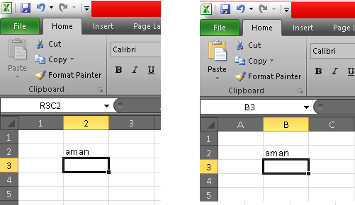
Contd…
Demo: R1C1 vs A1 reference style
INT510, Lovely Professional University, Phagwara

Slide 17
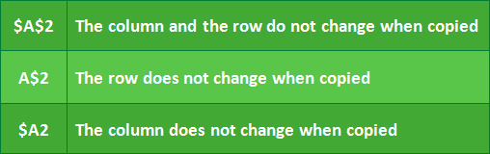
Contd…
There are two types of cell references:
Relative: change when a formula is copied to another cell.
Absolute: This references do not change when copied or filled. You can use an absolute reference to keep a row and/or column constant.
INT510, Lovely Professional University, Phagwara

Slide 18
6. Number formatting
Number formats in Excel control the display of cell values that contain numeric data.
This can include dates, times, costs, percentages, and anything else expressed as a number.
Check the image in next slide…
    Select a cell or a cell range
    On the Home tab, select Number from the drop-down
    Select the format you want
Or
    CONTROL + 1
INT510, Lovely Professional University, Phagwara

Slide 19
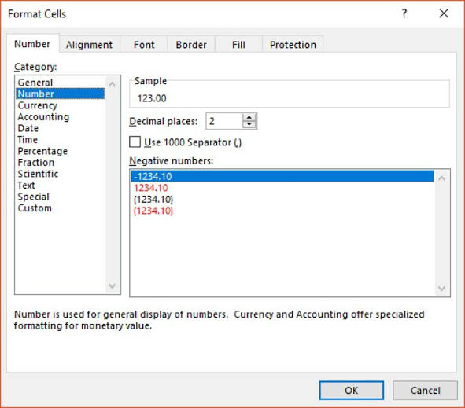
INT510, Lovely Professional University, Phagwara

Slide 20
7. Custom number formatting
An Excel number format consists of 4 sections of code, separated by semicolons, in this order:
POSITIVE; NEGATIVE; ZERO; TEXT
INT510, Lovely Professional University, Phagwara

Slide 21

Digit and text placeholders
Code | Description | Example
0 | Digit placeholder that displays insignificant zeros. | #.00 - always displays 2 decimal places. If you type 5.5 in a cell, it will display as 5.50.
# | Digit placeholder that only displays significant digits, without extra zeros. That is, if a number doesn't need a certain digit, it won't be displayed. | #.## - displays up to 2 decimal places. If you type 5.5 in a cell, it will display as 5.5. If you type 5.555, it will display as 5.56.
? | Digit placeholder that leaves a space for insignificant zeros on either side of the decimal point but doesn't display them. It is often used to align numbers in a column by decimal point. | #.??? - displays a maximum of 3 decimal places and aligns numbers in a column by decimal point.
@ | Text placeholder | 0.00; -0.00; 0; [Red]@ - applies the red font color for text values.
INT510, Lovely Professional University, Phagwara

Slide 22

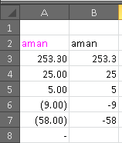
#,##.00;(#,##.00);"-";[Magenta]
Positive numbers (display 2 decimal places and a thousands separator).
Negative numbers (the same as for positive numbers, but enclosed in parentheses).
Zeros (display dashes instead of zeros).
Text values (display text in magenta font color).
INT510, Lovely Professional University, Phagwara

Slide 23
8. Conditional formatting
Conditional formatting is used to change the appearance of cells in a range based on your specified conditions.
The conditions are rules based on specified numerical values or matching text.
Changing the appearance of cells can visually highlight interesting data points for analysis.
INT510, Lovely Professional University, Phagwara

Slide 24
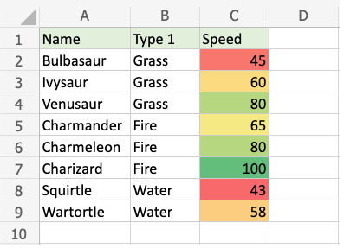
Select the range
Click on the Conditional Formatting icon
    from the Home menu
Select the Color Scales from the drop-down menu
INT510, Lovely Professional University, Phagwara

Slide 25
9. Format as table
Select a cell within your data.
Select Home > Format as Table.
Choose a style for your table.
In the Format as Table dialog box, set your cell range.
Mark if your table has headers.
Select OK.
INT510, Lovely Professional University, Phagwara

Slide 26



